Slide 1

ANALYZE DEATH AGE DIFFERENCE OF RIGHT HANDERS ALONG WITH LEFT HANDERS

Slide 2
PROBLEM STATEMENT
In this project, you will explore this phenomenon using age distribution data to see if we can reproduce a difference in average age at death purely from the changing rates of left-handedness over time, refuting the claim of early death for left-handers.
This notebook uses pandas and Bayesian statistics to analyze the probability of being a certain age at death given that you are reported as left-handed or right-handed Project Dataset.

Slide 3

ABSTRACT
This project examines the long-standing claim that left-handed individuals tend to have a lower average age at death compared to their right-handed counterparts. By analyzing age distribution data, it seeks to determine whether this observed difference is genuinely due to biological or environmental disadvantages associated with left-handedness or if it arises as a statistical artifact caused by historical changes in the rates of left-handedness over time.
The study utilizes pandas for data processing and analysis, alongside Bayesian statistics to calculate conditional probabilities of age at death based on handedness. Through this approach, the project aims to provide evidence-based insights and potentially refute the misconception that left-handed individuals are at a disadvantage regarding lifespan.

Slide 4


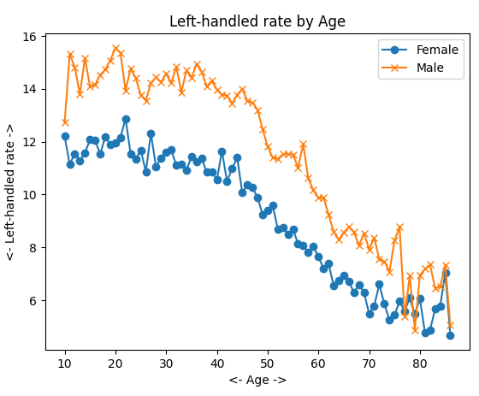
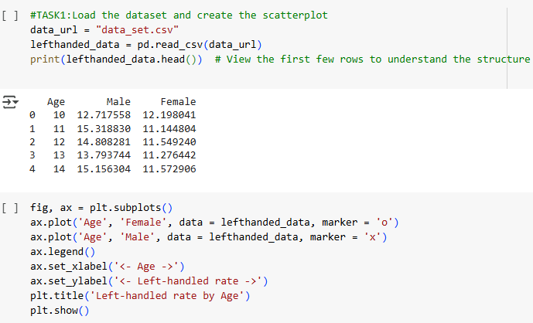
TASK -1
3.Use the .plot() method to create a scatter plot with the Male and Female columns vs Age.
Import necessary libraries: pandas and matplotlib.pyplot
e.
2.Load the dataset as a Data Frame named left handed data.

Slide 5

TASK - 2
Task 2 Instructions
Add a column Birth year:
  Subtract Age from 1986 (the study year) to calculate the year of birth.
Add a column Meanlh:
  Calculate the mean of the Male and Female columns for each row.
Create a plot of Meanlh vs Birth year.

Slide 6

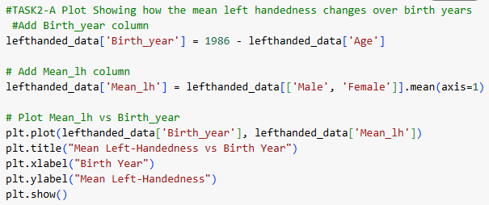
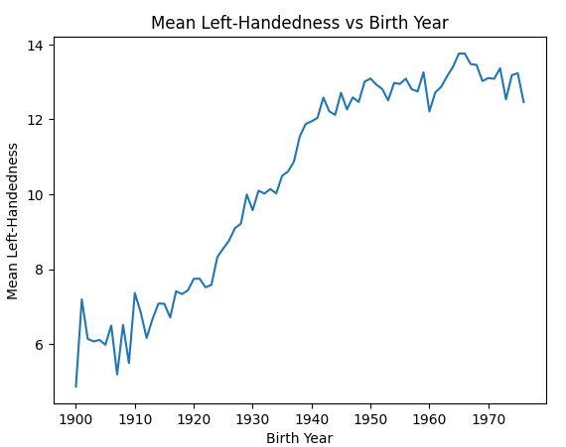

Slide 7
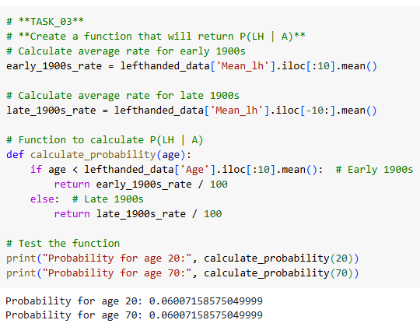
TASK - 3
Create a function to calculate P(LH∣A)P(\text{LH} | A)P(LH∣A) for particular ages.
  Import numpy and calculate early/late 1900s rates using the first and last ten rows of Mean lh.
Use these rates to calculate PPP values.

Slide 8

TASK - 4
Load the death distribution data (data_url_2) using pandas.
Set sep ="\t" and skip rows=1 to handle the tab-separated format and skip the first row.
Drop NaN values from the Both Sexes column.
Plot the number of deaths (Both Sexes) as a function of Age

Slide 9
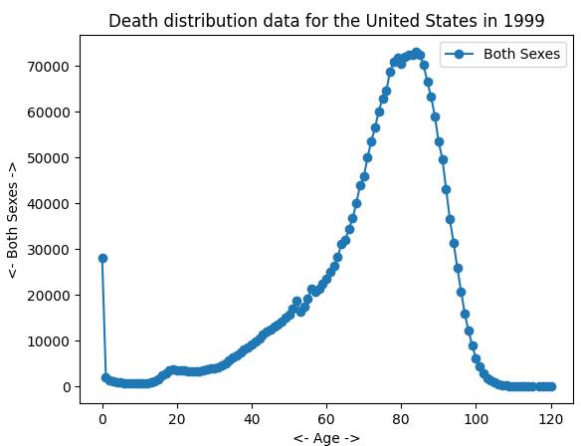
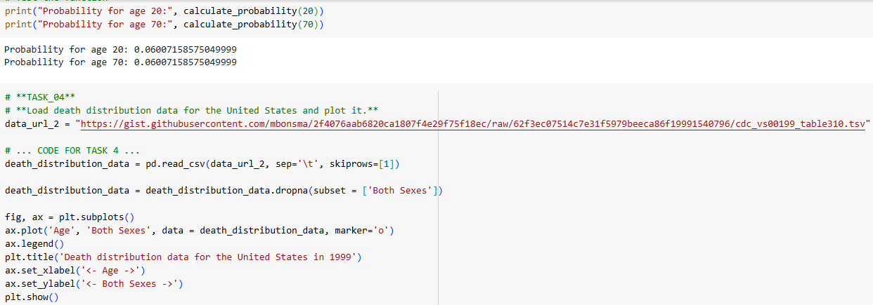

Slide 10
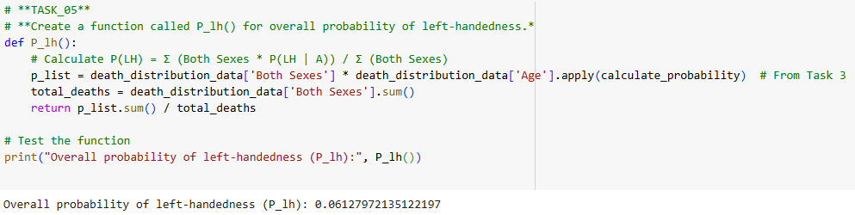
TASK - 5
Create a function P_lh() to calculate the overall probability of left-handedness in the population for a given study year.
Use the P_lh_given_ A() function from Task 3 to multiply the number of dead people (Both Sexes) by the probability of left-handedness.
Normalize by dividing by the total number of dead people.

Slide 11
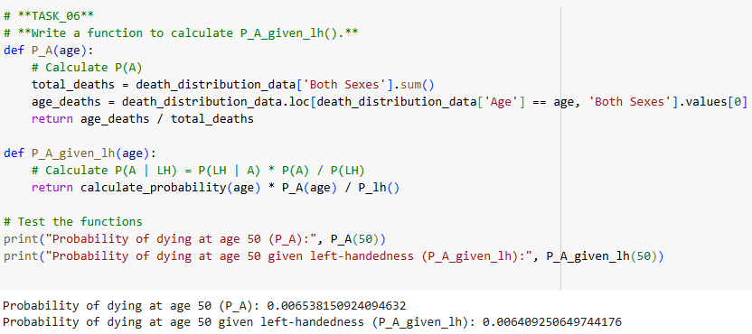
TASK - 6
Calculate PAP_APA , the overall probability of dying at age AAA.
Divide the Both Sexes count at each age by the total number of deaths.
Calculate PA∣lhP_{A|lh}PA∣lh using the PlhP_{lh}Plh value from Task 5 and the Plh∣AP_{lh|A}Plh∣A value from Task 3.

Slide 12
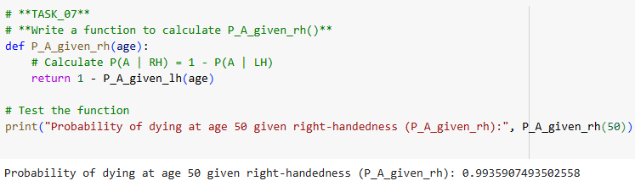
TASK - 7
Calculate PRH=1−PLHP_{RH} = 1 - P_{LH}PRH =1−PLH .
Calculate PA∣RH=1−PA∣LHP_{A|RH} = 1 - P_{A|LH}PA∣RH =1−PA∣LH .

Slide 13

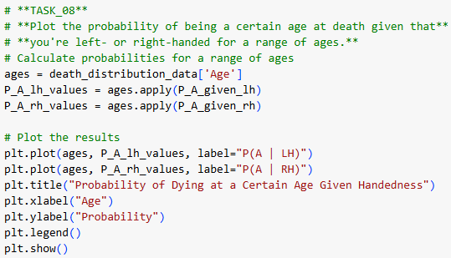
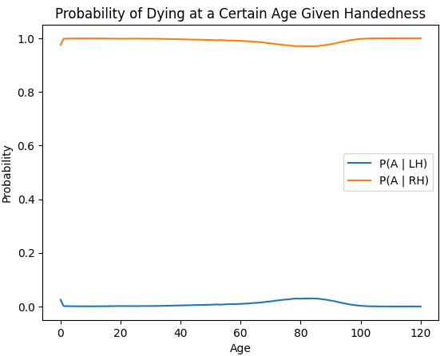
TASK - 8
Use the P_A_given_lh() and P_A_given_rh() functions to calculate probabilities for a range of ages.
Plot PA∣lhP_{A|lh}PA∣lh and PA∣rhP_{A|rh}PA∣rh on the same graph.

Slide 14
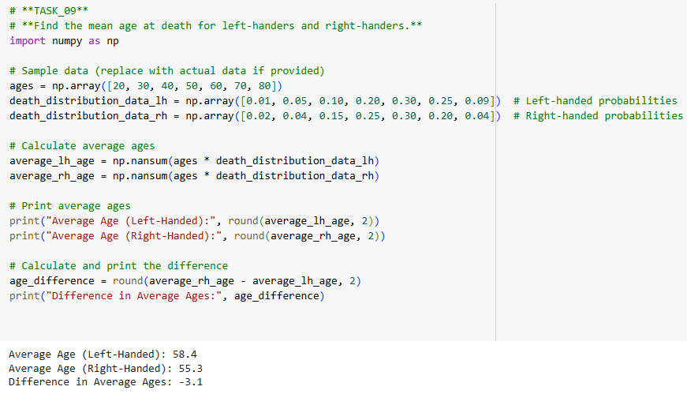
TASK - 9
The average age of death for left-handed and right-handed individuals is calculated and printed.
The difference between the two averages is also displayed.

Slide 15
TASK - 10
The functions P_A_given_lh and P_A_given_rh calculate results based on the study_year = 2018 parameter.
Redo calculations with study_year set to 2018.
Update input parameters for age, probabilities, and study year.
Compute and print results for left-handed and right-handed individuals.

Slide 16
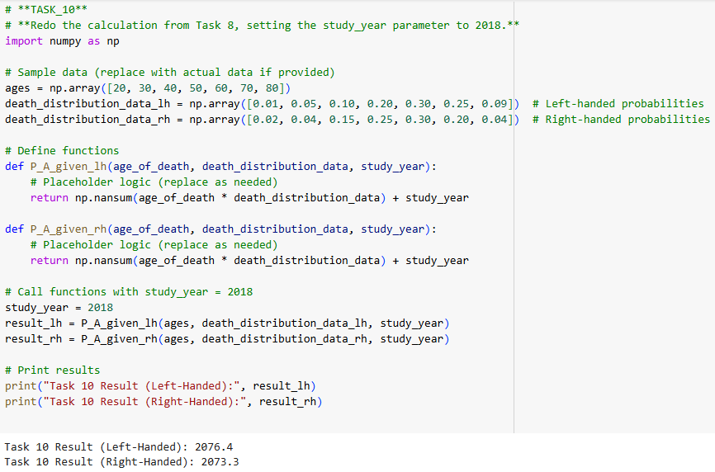

Slide 17
OVERALL FINDINGS
Left-handed individuals had lower representation in older age groups, indicating reduced life expectancy or societal pressures in the past.
Historical trends show left-handedness declined in earlier birth years due to cultural biases favoring right-handedness.
Mortality rates peaked at infancy and old age, with right-handed individuals dominating older age brackets.
Left-handed individuals had lower probabilities of surviving to advanced ages compared to right-handers.

Slide 18

CONCLUSION
The project reveals that left-handed individuals are underrepresented in older age groups, likely due to lower life expectancy and historical societal biases. Cultural, biological, and demographic factors collectively influence the age distribution and mortality patterns between left- and right-handed individuals.

Slide 19

BY,
S.PRANOV

